Slide 1

Object Classiﬁcation and Counting with Count-ception Network
Author: Zhou Yinan
Supervisor: Giacomo Boracchi
Co-supervisor: Diego Carrera

Slide 2
Index
Problem Formation
A Baseline Approach
Modified Count-ception Network
Conclusion and Improvements

Slide 3
Index
Problem Formation
A Baseline Approach
Modified Count-ception Network
Conclusion and Improvements

Slide 4
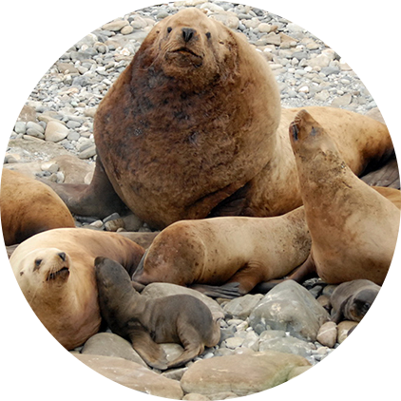
Problem Formation
Problem: five types of sea lions in high resolution images
Goal: estimate the number of each type of sea lion in testing images
Thesis: object classification + object counting with deep learning architecture
Usage: automate preliminary information gathering for various researches, for example endangered animal protection, biological imaging analysis, surveillance...

Slide 5
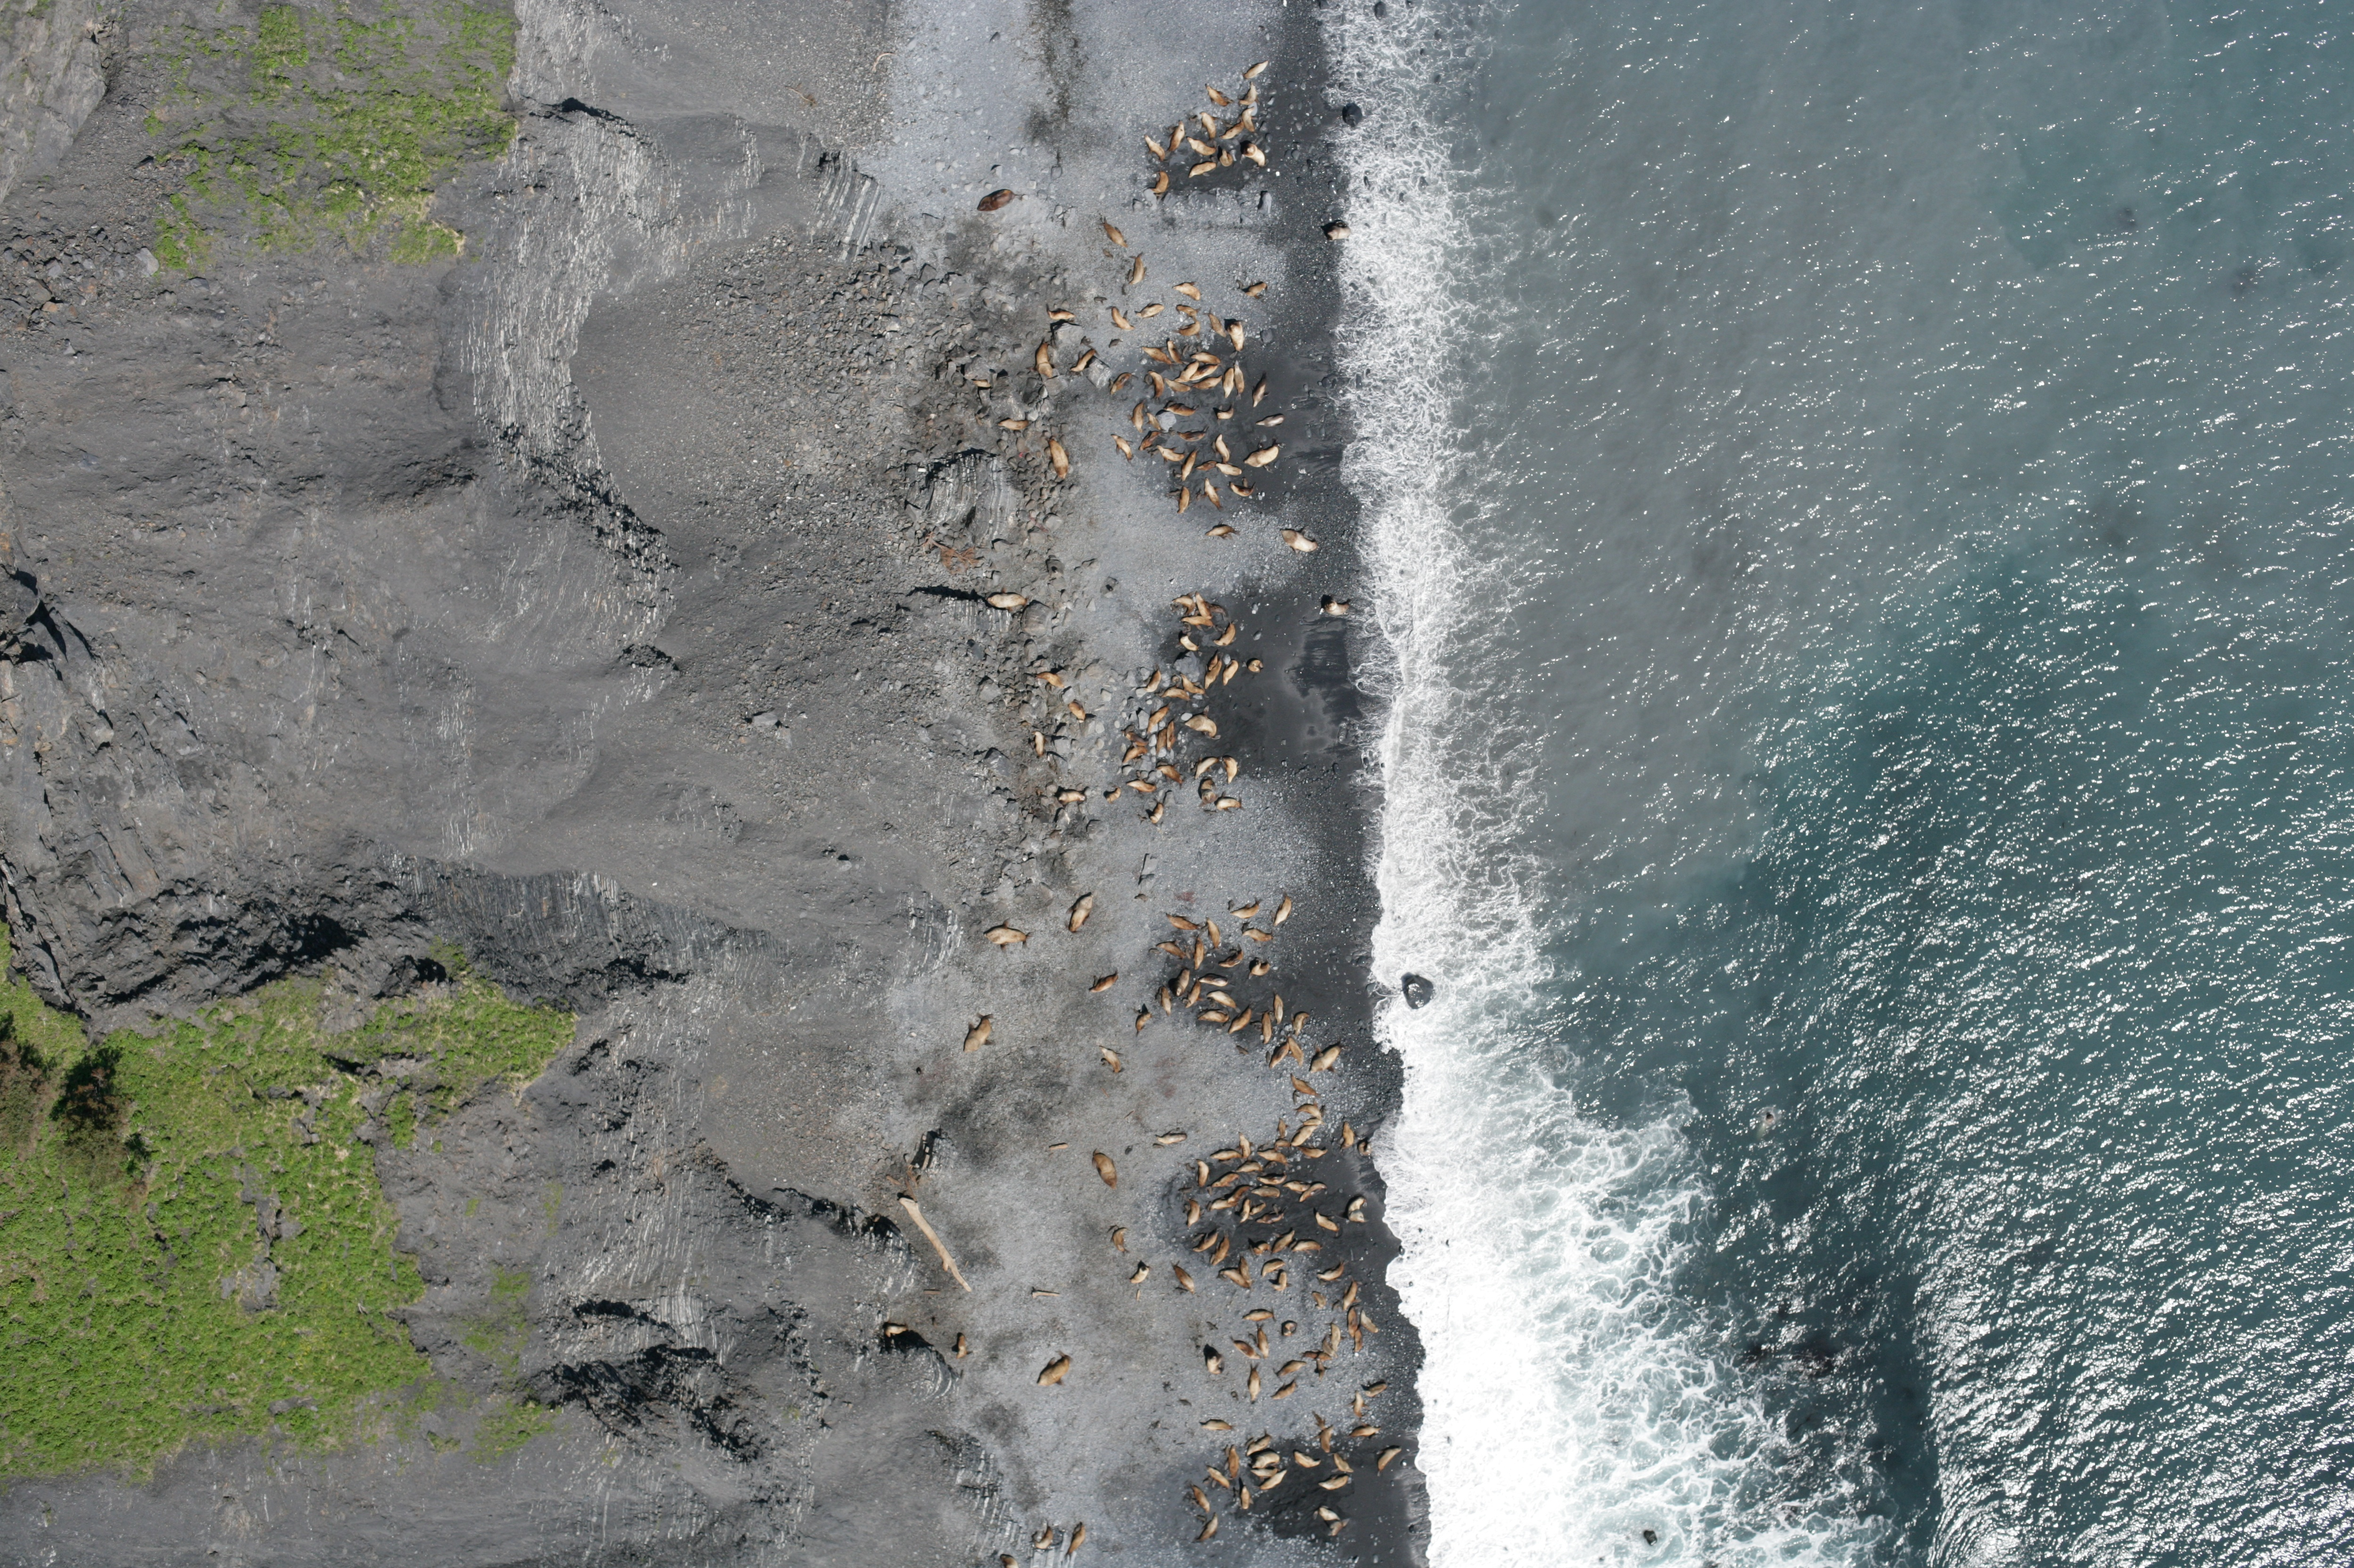
Problem Formation
adult males = 2
subadult males = 5
adult females = 20
juveniles = 18
pups = 0
totally 947 images
each image of size 4k x 3k
training 763, testing 184

Slide 6
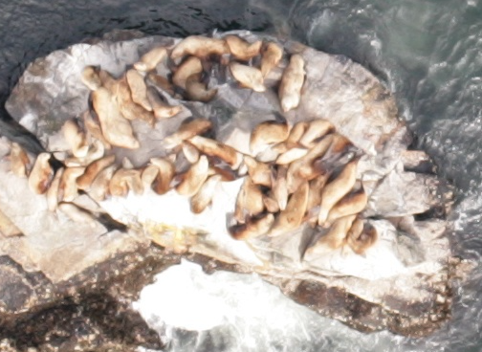
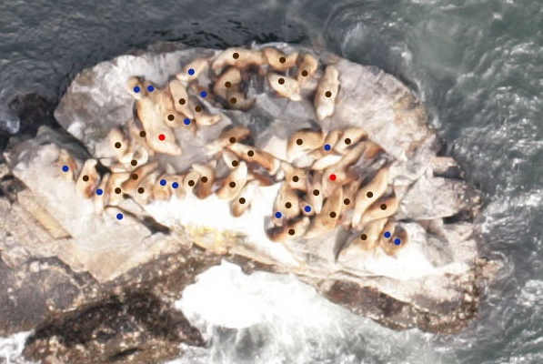
Problem Formation
original image
dot label image

Slide 7
Problem Formation
Challenges:
Tiny similar objects in complex backgrounds
Not so much training info provided, only center dots in the object
High resolution images causing memory issue
Unbalanced sea lion type distribution

Slide 8
Index
Problem Formation
A Baseline Approach
Modified Count-ception Network
Conclusion and Improvements

Slide 9
A Baseline Approach
Patch extraction with convolutional neural network (CNN)
Blob detection to get color dot coordinates
Patch extraction from original images
Build CNN to learn to classify patch: 5 sea lion types + background
To make inference, first separate testing image into non-overlapping patches, then sum up all the classification results to generate estimated counts

Slide 10
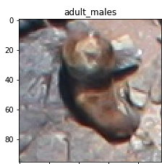
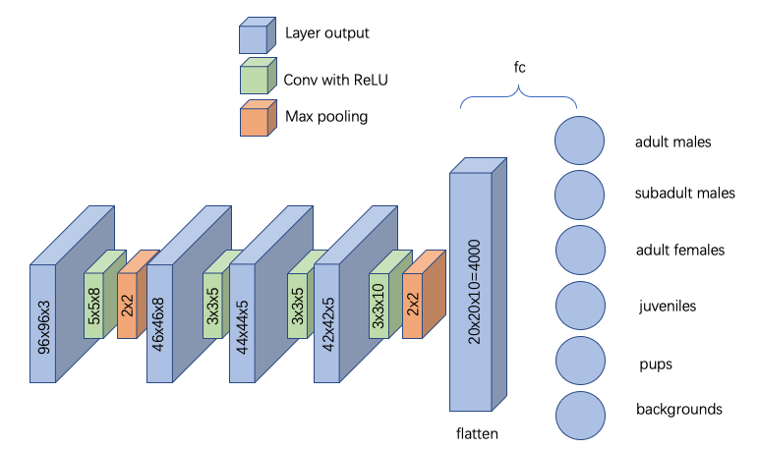
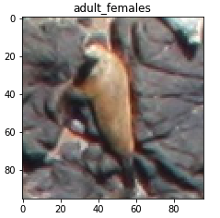
A Baseline Approach

Slide 11
A Baseline Approach
sea lion types | adult males | subadult males | adult females | juveniles | pups
avg count error | 25.77 | 40.98 | 7.53 | 199.75 | 314.83
Issues
Assume each sea lion lies in the center
Assume each patch contains at most one sea lion

Slide 12
Index
Problem Formation
A Baseline Approach
Modified Count-ception Network
Conclusion and Improvements

Slide 13
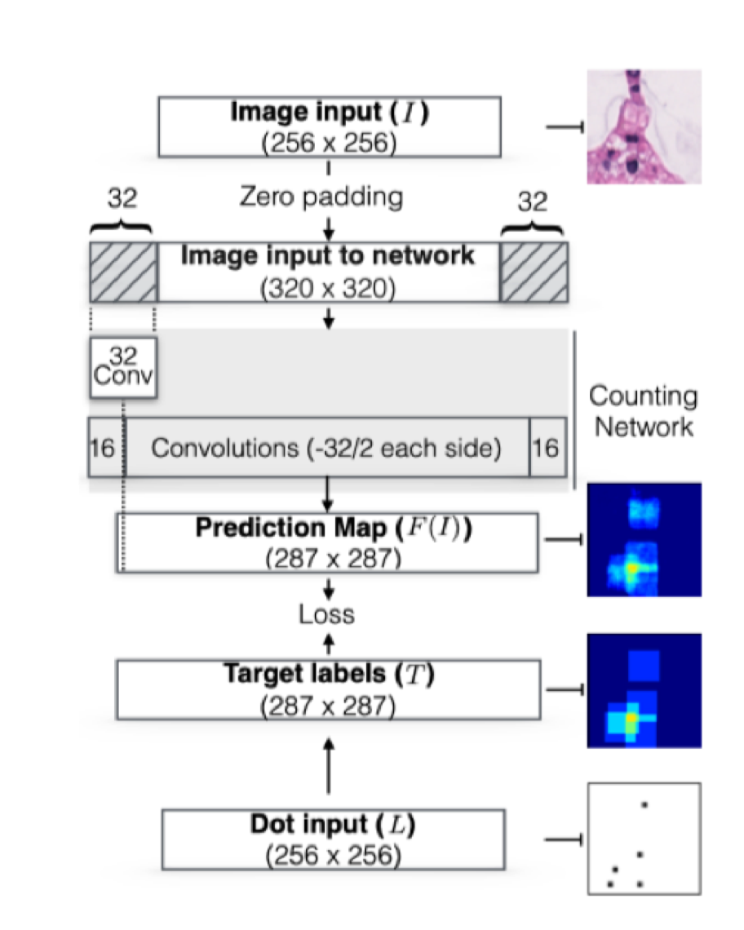
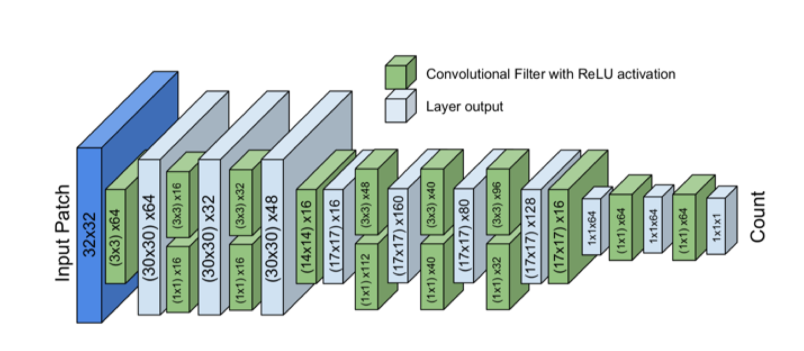
Modified Count-ception Network
Count-ception network

Slide 14
Modified Count-ception Network
Characteristics
Regression network based on Inception module
Fully convolutional network
no fully connected layers
no requirement of fixed input image size
can be converted to fully connected layers back and forth
train the network in a fully convolutional way is equivalent to mini-batch training, but a lot faster

Slide 15
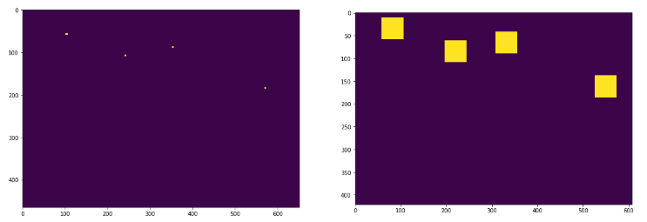

Modified Count-ception Network
Target map construction
redundant counting
$$\#counts=\frac{sum\left(target map\right)}{r∗r}$$
convolution

Slide 16
Modified Count-ception Network
Append more convolution filters at the last layer
add classification functionality
Adjust receptive field size
from 32x32 to 96x96
big enough to cover each sea lion type
Insert weight balance layer
deal with sparse object distribution
deal with non-uniform sea lion type distribution

Slide 17
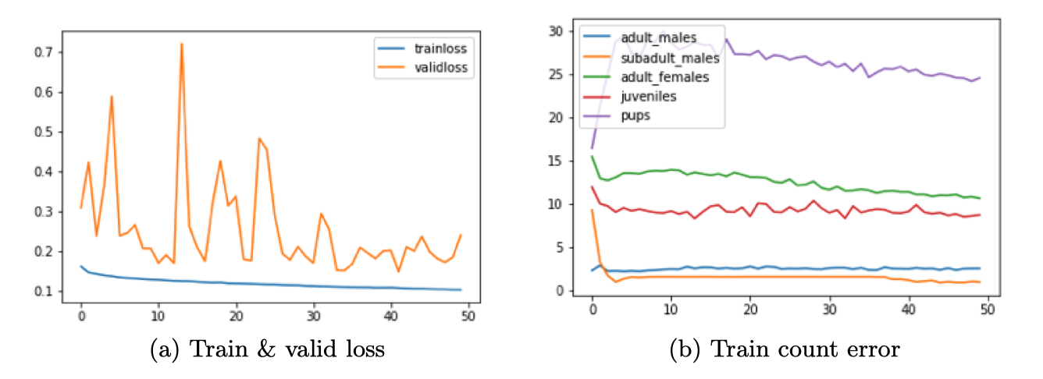
Modified Count-ception Network
sea lion types | adult males | subadult males | adult females | juveniles | pups
avg count error | 47.0 | 6.3 | 40.0 | 21.3 | 35.8

Slide 18
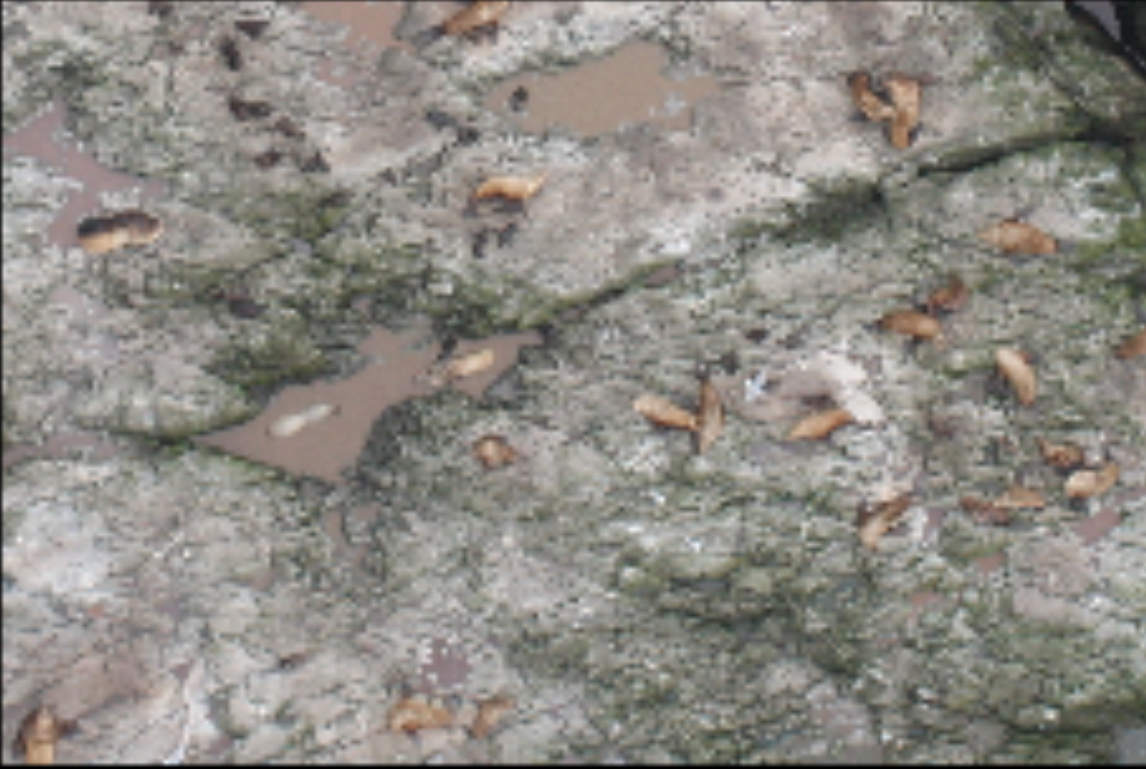
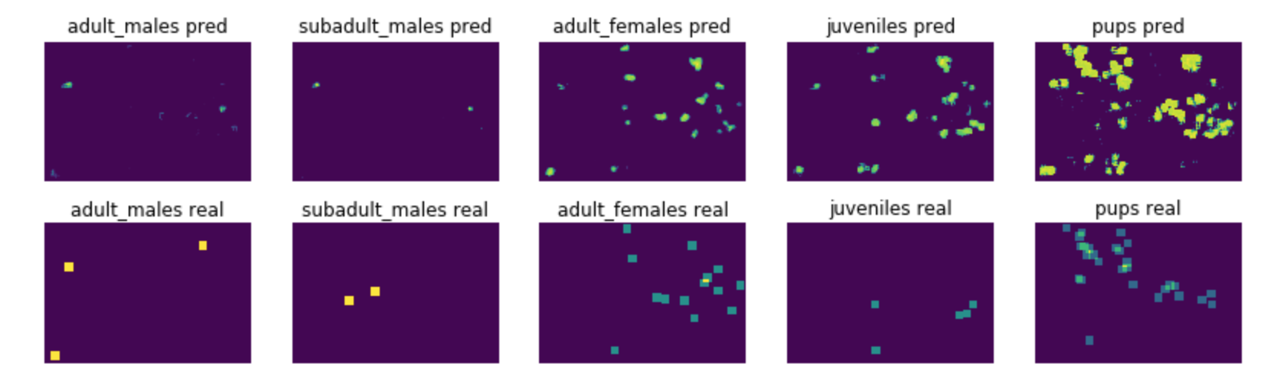
Modified Count-ception Network
FP is an issue

Slide 19
Index
Problem Formation
A Baseline Approach
Modified Count-ception Network
Conclusion and Improvements

Slide 20
Conclusions
Modified Count-ception network works better than baseline approach
Train the network in fully convolutional manner has the following benefits:
able to do training with few training data
able to deal with sparse training when weight balance layer is used
suits for objects counting which are close to each other
a lot faster than equivalent batch-wise training
Complex backgrounds and FP is a problem
Memory consumption is an issue

Slide 21
Conclusions
Challenge solutions:
Tiny similar objects in complex backgrounds
inherent difficulty
Not so much training info provided, only center dots in the object
train the network in fully convolutional manner which implicitly creates highly overlapping patches
High resolution images causing memory issue
each image is separated into 25 parts
Unbalanced sea lion type distribution
weight balance layer

Slide 22
Further Improvements
High GPU memory to avoid image separation
More complex Count-ception architecture
Spatial correlation in heat maps

Slide 23
Thanks
Q&A

